Slide 1
COVID-19 and its effects on children & young people
Dr Jennifer Skattebol
Social Policy Research Centre

Slide 2
Covid-19 – a pause for breath
Wendy Brown (2020)
“The occasion to rethink our order, to ask what it means to be more preoccupied with the health of the economy than the survival of the planet and all forms of life on it” has to be “articulated and pursued as an active organizing principle.”
Bruno Latour (2021)
“ the health crisis is not embedded in a crisis but in an ongoing, irreversible ecological mutation.”
Notes:
Globalisation
It is not just the multinationals, or the trade partnerships, or the internet, or the tour operators that globalize the planet.
Every entity on this same planet has its own unique way of hooking up, the one with the other, plus all the other elements
that compose the collective at a given moment. This is true for the carbon dioxide that is warming the atmosphere globally by spreading through the air, and for migrating birds carrying new kinds of flu; but it is also true for — we are learning at our peril once again — the coronavirus, which has the capacity to link all humans by passing through our apparently inoffensive droplets as we cough. Germs are super globalizers: when it is a matter of resocializing billions of people, the germs make short work of it!
policy measures previously deemed impossible were taken within a matter of hours or days when the deadly impact of COVID-19 came into sight

Slide 3
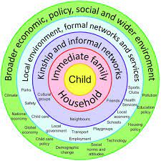
Ecological model for understanding children’s development and learning are widely accepted
Notes:
term was widely popularised in 2000 by atmospheric chemist Paul J. Crutzen – indicates humans have enormous impact on the environment
Follows the holocene

Slide 4
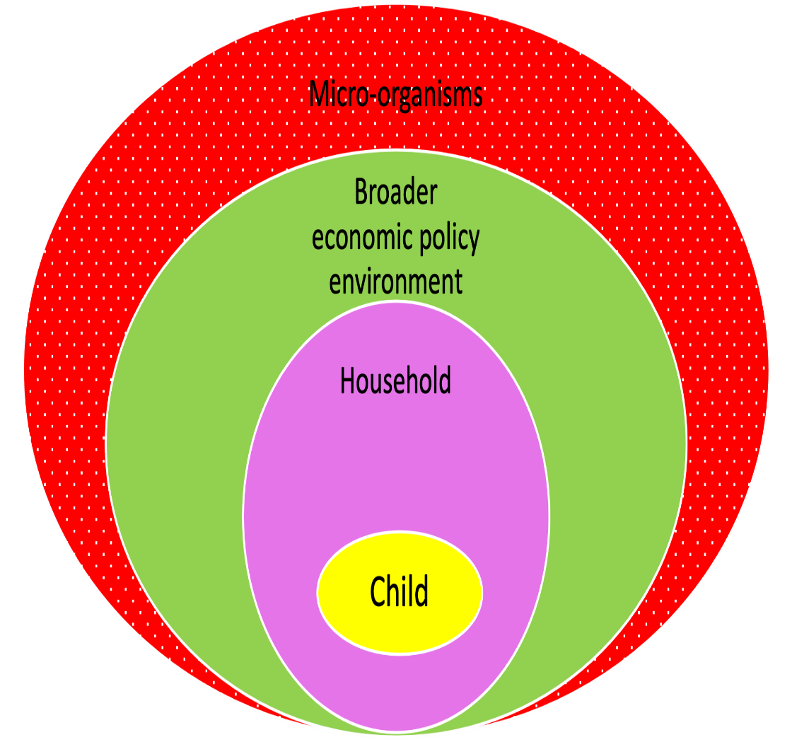
Ecological models in Covid times
Notes:
Educational trajectories unfold in environments defined immediately by families, schools and communities, and more distantly by other social, economic and cultural institutions.
These institutional systems and subsystems are interconnected in influencing young people’s lives.
Educational trajectories are also organised around life course stages or categories, marked by shared experiences, events and transitions.
Individuals’ lives influence and are influenced by those of others.
Educational trajectories take place on the territory of this planet, which has as much impact on how these trajectories unfold as institutions and policy constellations – think climate refugees – Covid.

Slide 5
Factors associated with risk of educational disadvantage
Student
Being male + low SES
Sexual orientation/gender Identity
Health developmental conditions
Family
Low SES
Parenting/family functioning
Internet access and usage
School
Poorly resourced home environment
Limited or poor early childhood education and care
Limited teacher support/school connectedness
Limited social support (community)
Notes:
Lamb (2015) suggests that the gender differences are most pronounced for the domains of social competence and emotional maturity, or social and emotional development. The AEDC (2014) report that these gender differences do not appear to have longer term consequences for educational outcomes, however our secondary data analysis suggests being male is a risk factor for negative educational outcomes for Cohorts 1 and 2, and another study recently undertaken (in press) shows persistence in poorer educational outcomes in boys who started school behind.

Slide 6
New normal of microbiological threat: Lock downs
ECEC
Shift from demand side to supply side funding
Considered essential services
Jobkeeper
Schools
School closures
Rapid shift to online pedagogies
Allied professionals were not considered essential
Tertiary Sectors
No international students
No jobkeeper
Shift to online learning
Mass redundancies
3 cohorts most affected
Young children starting school behind their peers
Older students already at risk of disengagement
Children and young people who have had contact with the child protection system

Slide 7
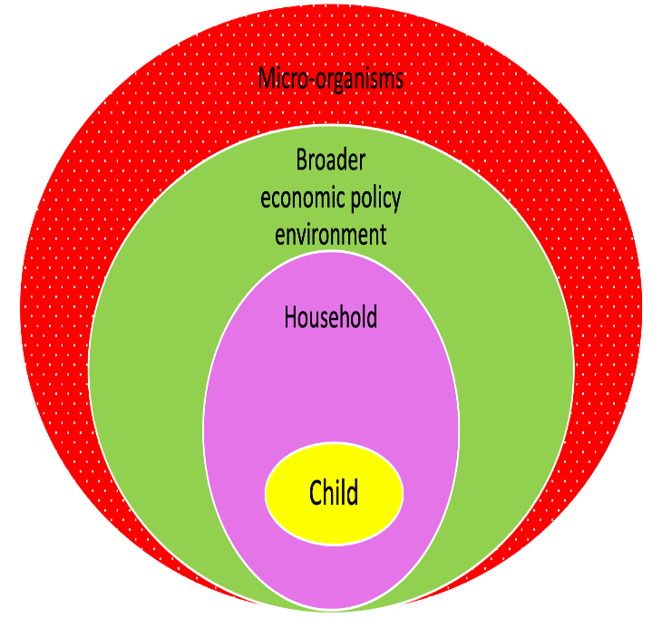


Covid-19, lock downs on children in low SES circumstances
Schools and teachers
Had to deliver and track students remotely
Loss of allied professionals
Online pedagogies are very different to face to face pedagogies
Remain open for children at risk placing teachers at risk
Had own familial responsibilities
Families
  experience loss of income (covered by job keeper and job seeker in immediate period but not over longer term)
  are ‘locked in’ exacerbating intra-familial stress
  become responsible for schooling
  need to trouble shoot IT issues
Students
Disrupted connections to teachers and peers
Self directed in learning
Reliant on their own IT skills
Reliant IT resources in home and neighbourhood

Slide 8
The ecological system was missing its middle rings

Slide 9
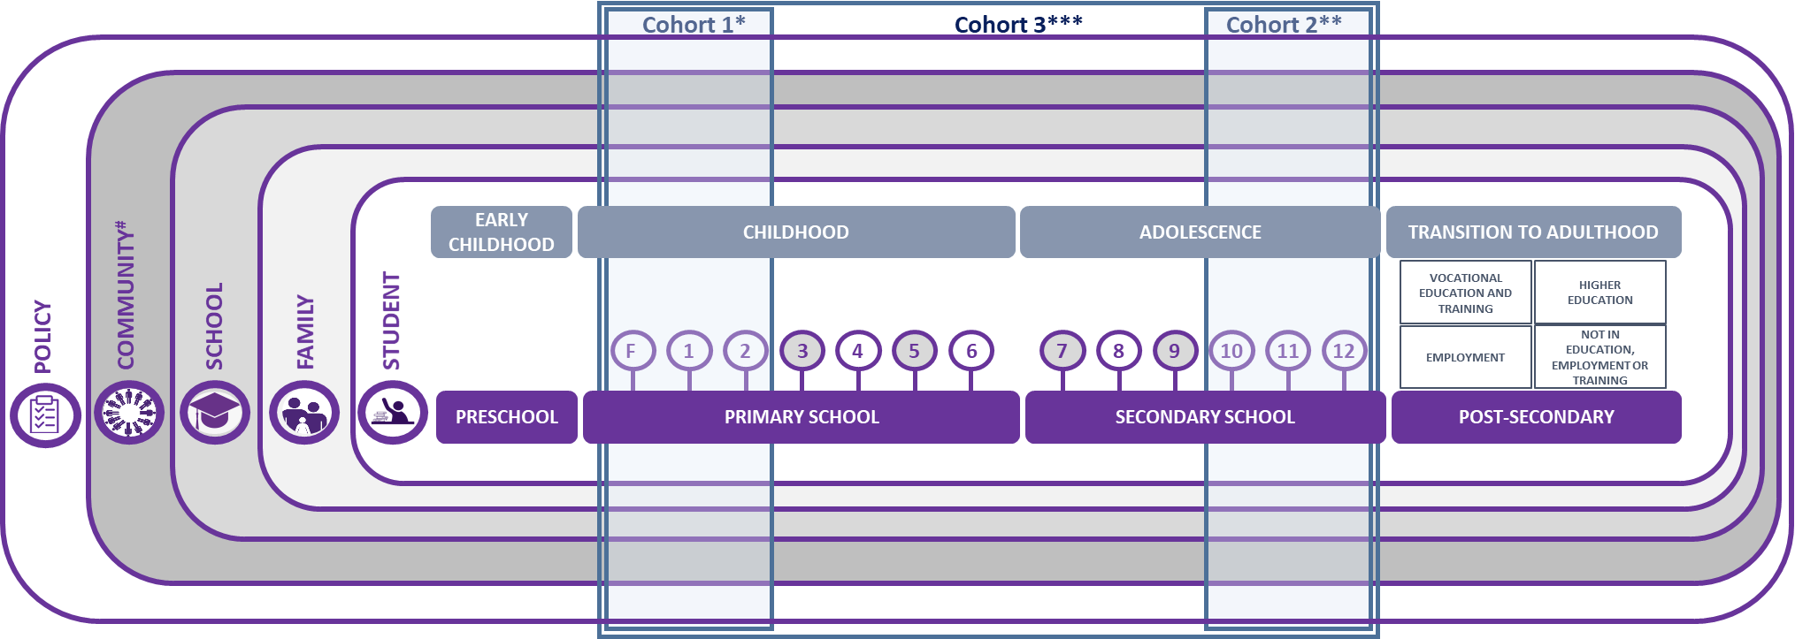
Learning through Covid-19 study – ISSR.

Slide 10
Learning through Covid Study
Methods
Policy Mapping
Data from NSW and Tasmanian education departments
  Tell Them From Me
  Naplan
  Admininstrative data
Interviews
  Children and young people (n=39)
  NGO stakeholders (n=21)
Stakeholder survey (n=50 – NFG, schools, policy allied professionals))
Academic roundtable
Rapid and grey literature scans
Secondary data analysis of risk factors that compound educational disadvantage
  ((Longitudinal Survey of Australian Children (LSAC), the Longitudinal Surveys of Australian Youth (LSAY), as well as publicly available statistics published by the Australian Bureau of Statistics (ABS), the Australian Institute of Health and Welfare (AIHW), the Australian Curriculum, Assessment and Reporting Authority (ACARA), and the Reports of Government Services))

Slide 11
Experiences of Covid changes
“It made me a bit sad because I can’t see my friends or my teachers and I can’t do everything at school. [...] Because I didn’t get to do a lot of things at school. Because there’s art class, there’s library, there’s the pool, and I don’t get to do all that stuff at home.” Interviewee 16, female, primary school.
“COVID was actually great for me. I loved having online school. When we went back to school, I actually had like a panic attack -I was like, ‘I don’t want to go back to school and deal with these people in real life’ because online is so much better because a lot of people can’t join,– the people that like get on my nerves or make me anxious, like they’re not there so it’s like so chill and like the chill people are online, so it’s like really good.” Interviewee 35, female, flexi-school.
“It’s been hectic. [...] one thing after the other was just – we’ve had a lot of build-up to COVID happening. COVID was just the icing on the cake for us, to be honest.”
Parent of Interviewees 33 and 34, female, primary school.

Slide 12
Going back to school
“I couldn’t really catch up with the classes, because I missed a few. Because of the wi-fi I couldn’t really access to the online learning, online content, material stuff, and then I was behind.” Interviewee 17, female, secondary school.
“I still have homeworks behind from last term or during the COVID-19. But I’m still working on them to finish them off to get my mark high to get passed for my course, my subject.” Interviewee 20, female, secondary school.

Slide 13
School/child and school/family connectedness in low ses contexts
Many parents/carers in low SES contexts have experienced institutional schooling failures and find it hard to trust schools
  School connectedness is essential to learning
  Routine and pastoral care is essential to learning
Allied professionals and flexischools are an essential part of today’s equity architecture
  act a brokers between families and schools
  staff ‘safe’ spaces for children in schools and communities
  Highly relational work and often via physical programs (eg creating chances)
Lock downs and restrictions disrupted the access of these brokers
Broker organisations were not equipped for online engagement
Resources available via education departments were triaged

Slide 14
Domain | Emerging issues | Responses | Long term
Child/young person | Loss of learning /engagement Mental health Loss of safety beyond the home | Parachuting in tutors (Grattan institute) | Youth engagement and voice at local levels including pedagogy design
Institutions – schools ECEC settings, tertiary settings | Teacher capacity System capacity to move to digital learning environments Teacher mental health | Delivery of IT resources Blended learning skills (teachers and students) Pedagogies based on young people’s experiences (?) | Recognition of pastoral care professionals Attention to school/family interface Better infrastructure and digital resourcing in low SES communities
Family/community | Pressure on families to ‘teach’ , manage lock down, digital interfaces, manage income and job precarity over time | Job keeper/seeker Supports for mental health and family functioning | Raise the minimum wage and welfare payments Support families IT skills

Slide 15
Post Covid education: What do we want?
What are some suspended activities/processes/structures that you would like to see not coming back?
Why does this activity/process/structures seem to be dangerous/incoherent and how its disappearance might render other activity/process/structures that are easier/more coherent?
What kinds of measures would permit teachers/students to facilitate the transition to other activity/process/structures ?

Slide 16
References
Brown, Wendy. 2020. “ ‘A Worldwide Mutual Pact’: An Interview with Wendy Brown.” Drift, no. 1 (June 24).
Latour, B., & Muecke, S. (2021). Protective Measures: An Exercise. Cultural Politics, 17(1), 11-16.
Lamb, S., Jackson, J., Walstab, A., & Huo Shuyan. (2015). Educational opportunity in Australia 2015: who succeeds and who misses out, Centre for International Research on Education Systems, Victoria University, for the Mitchell Institute, Melbourne: Mitchell Institute.
McDaid et al. (2020). Learning through COVID-19: Pillar 1 Report: Who are the students most at risk of falling behind in their learning? ISSR
McDaid et al, (2021) Pillar 2 Report: What do children, young people and families say about needs, and impact of COVID-19? ISSR
Seymour, K., Skattebol, J., & Pook, B. (2020). Compounding education disengagement: COVID-19 lockdown, the digital divide and wrap-around services. Journal of Children’s Services
Smith Family. (2020). COVID-19 Insights Snapshot: The challenges of surviving COVID-19 in Australia’s hardest hit communities.

