Slide 1


End of life choices
Dr Margot Woods.
General Practitioner

Slide 2


Slide 3

Advance Care Directive (ACD)
Palliative care
Voluntary Assisted Dying (VAD)

Slide 4

Advance care planning
is a way to think about and record your health care preferences
comes into effect if you can't make decisions for yourself
nominates a person responsible
is legally binding
can be done formally or informally
NOT part of VAD
Advance Care Planning Australia
“A document that speaks in the silence”: Paul and Heather’s story of planning ahead

Slide 5
What is palliative care?
Palliative care is person and family-centred treatment, care and support for people living with a life-limiting illness.
A life-limiting illness is an active, progressive, or advanced disease, that has little or no prospect of cure and that you’re likely to die from at some point in the future.
Works in parallel with VAD

Slide 6
Voluntary Assisted Dying (VAD)
in NSW

Slide 7

Eligibility criteria 1
  • Adult
  • Australian citizen, permanent resident, or resident for 3 yrs
  • Living in NSW for at least 12 months

Slide 8
Eligibility criteria 2
Disease, illness or medical condition that:
is advanced and progressive and will, on the balance of probabilities, cause a person’s death within 6 months (or 12 months for neurodegenerative diseases) “Prognosis”.
is causing the person suffering that cannot be relieved in a way they consider tolerable

Slide 9
Eligibility criteria 3
  • Has decision-making capacity in relation to voluntary assisted dying
  • Acting voluntarily and not because of pressure or duress from another person
  • Have an enduring request for voluntary assisted dying.

Slide 10
Decision Making Capacity
A patient has decision-making capacity in relation to VAD if the patient has the capacity to:
understand information about a VAD decision, &
remember the information to the extent necessary to make a VAD decision, &
understand the matters involved in a VAD decision, and
understand the effect of a VAD decision, &
weigh up the factors referred to above for the purposes of making a VAD decision, and
communicate a VAD decision in some way

Slide 11
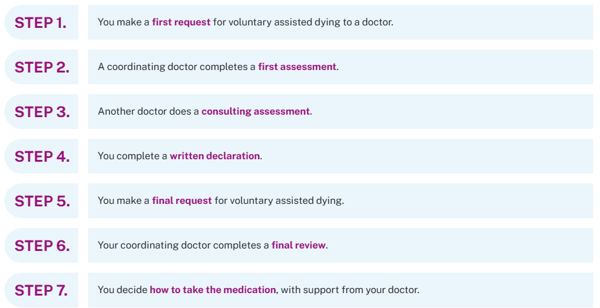
Steps in the VAD process

Slide 12
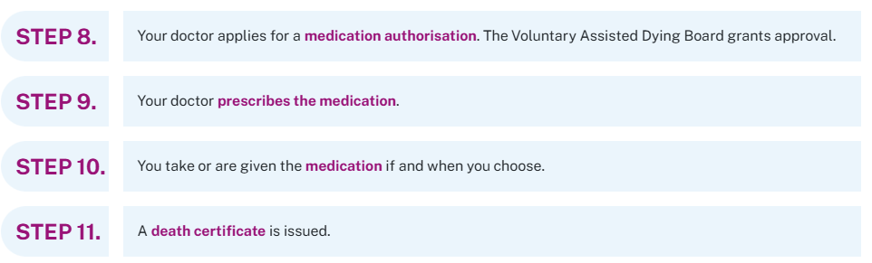
Stop, pause or change your mind at any stage.

Slide 13
Administration Decision
Self administration
Self- delivered to person to store at home
Contact person
Can take whenever they choose
Practitioner administration
Intravenous or Oral
Delivered to practitioner from state pharmacy
Person chooses the date -48 - 72 hours to organise

Slide 14
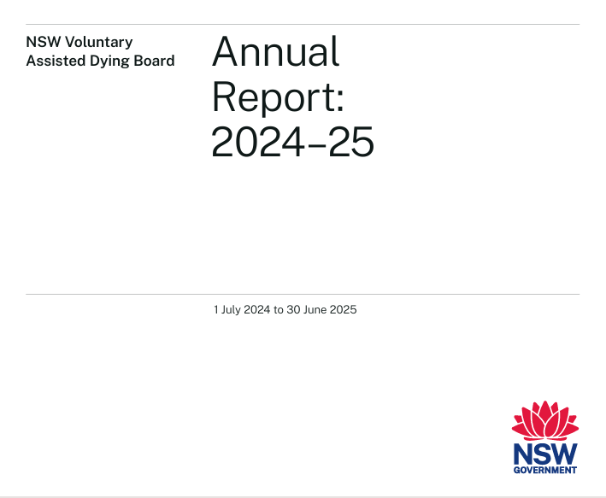


annual-report-2024-2025.pdf

Slide 15

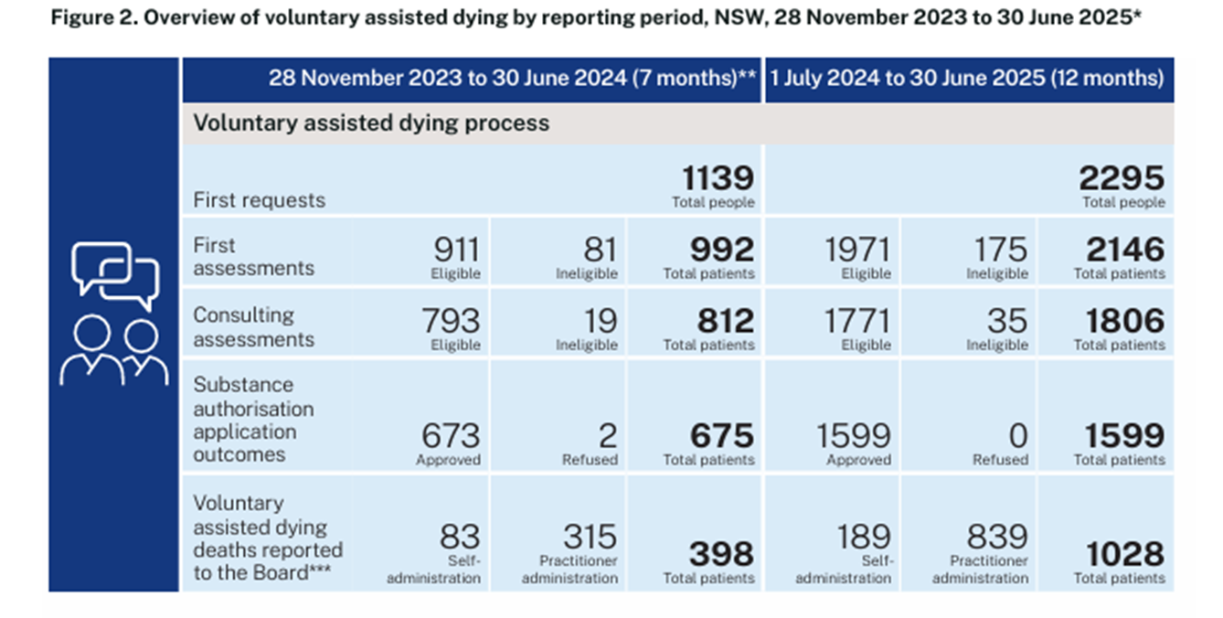
1.7% of total deaths in NSW

Slide 16
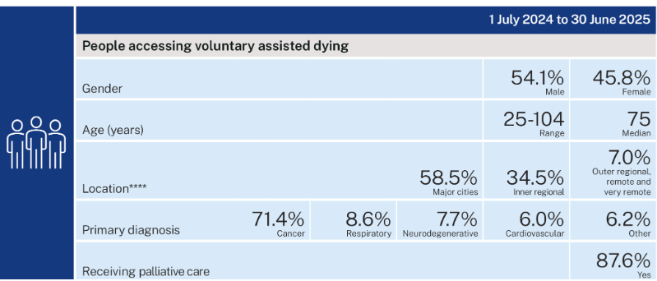

Slide 17
To speak to Care Navigator support staff
Call: 1300 802 133 Monday to Friday, 8:30am to 4:30pm (excluding public holidays)
Email: NSLHD-VADCareNavigator@health.nsw.gov.au

Slide 18



Go Gentle Australia
VAD in NSW - Dying with Dignity NSW 2024
What is voluntary assisted dying and who is eligible?

Slide 19
Take home messages..
Try to be become comfortable discussing end of life for yourself and those you love.
These conversations can become a gift to your family should something happen unexpectedly to you or one of them.
Ask what is the likely outcome for your health conditions ie “prognosis” as it helps you plan.
Ask early to allow choices.
People with conscientious objections are protected by law.
Know where to get more information

Slide 20
Questions

Slide 21


